Slide 1
How to ensure Common Unity in your ‘community’?
How to Start a Community Health Club
Module. 1.
Session. 1.
Notes:
Hi there and Welcome to the first topic in Part 1. of the Course
‘How to Start a Community Health Club’.
In this topic we will be analysing the concept of Community and a get a broad understanding of the concept by answering a very important question which is the key to our whole training: “What is a functional Community’

Slide 2
Module 1. | Time GMT+2 | Topic Title | Presenter
Session 1. | 1.30. pm | Participant Sign in | Anthony Waterkeyn
 | 2.00. | Welcome and Introduction | Juliet Waterkeyn
 | 2.10. | Powerpoint presentation ‘How to create Common Unity in Community’ | Juliet Waterkeyn
 | 2.45 | Video ‘CHC in Zimbabwe’ | https://vimeo.com/462614695
 | 3.00 | TED Talk | www.youtube.com/watch?v=ug3D0B4gcjs
 | 3.20 | Questions and Discussion | Dr. Jason Rosenfeld with Participant response
 | 4.00 | End of Session

Slide 3
1.1. What is a functional Community?
Definition of Community
Common Unity
A functional or dysfunctional ‘community’
Our role as Community Workers
Social networks and social capital
What is a Community Health Club
Notes:
In this session
We define the word ‘Community’
Examine the syntax of the word Community and discuss i.e. Common Unity
Identify a functional community and a dysfunctional community
Understand our fundamental role as community workers
Understand importance of social networks and social capital
Understand social networks the meaning of Social Capital
By the end of this Topic, ‘you should be able to answer the deceptively simple question:
What is a Functional Community?’

Slide 4
1.2. Definition of a ‘community’
the common people i.e. the beneficiaries of a project
a group of people in the same neighborhood
a group of people who are well connected and interact
a real Community group who manage their own challenges
Notes:
1.2. Definition of a Community
Send a snap poll of your understanding of the definition of community
How often do we use the word community in our proposal writing to mean ‘A’ the beneficiaries, or ‘B’ as if they are a well coordinated group.
e.g. ‘We will consult the community at all stages of the programme.’
Meaning we plan to talk to a few of the village leaders.
Is this really a reflection of the whole village?
The definitions ‘C’ and ‘D’ do give us an idea that the people in the area know each other and work together to some degree, but how often is this really the case.
In many cases there is an assumption that the community have a sort of magical mental telepathy.
e.g. The community gives priority to the need for water?
Really? Or is that just the manager imagining that is what would be their logical preference.
Do we actually know how well coordinated they are in reality.
How often do they meet? Every month, every year, ever?

Slide 5
1.3. Degree of Common Unity
Variation between
Means of production
1. Urban and Rural
2. Rich and poor neighborhoods
3. Traditional and Modern
Means to Organise
Notes:
1.3. Common Unity
The best way to understand the word Community is to split it into – Common / Unity.
Perhaps ‘in the old days’ there was some Common Unity, before people were mobile, before they left their village and before most services were professionalized, where there was a specialization of skill with in the area. If you wanted a horse-shoe you went to the blacksmith, some bread you went to the baker. Then everyone needed each other and they had the opportunity to meet often.
How much Common Unity exists now? It varies from urban/rural and rich/poor areas.
By frequent interaction: What opportunities do people in a rural village have to meet during the day? They can meet when they go to fetch water, they can walk back with their friends and talk. Gossip create common unity. What happens when they no longer have to fetch water but it is piped to their homes?
By living and working together people in a small geographical area, can develop strong social networks between families and this leads to a common vision for the area.

Slide 6
1.4. What do we mean by a Functional / Healthy Community?
1) Good leaders able to take care of all members
2) Can organise itself to deal with local challenges
in order to Spiral out of Poverty
Notes:
1.4. A FUNCTIONAL COMMUNITY – spiral out of poverty
People who live in a functional community would probably share norms and values in life, even if they did not own the means of production, they would have means to organise.
In the ideal well networked village with high Common Unity
There would be an active political leader, who would effectively manage
system of policing to ensure people’s rights are protected
enough clean water and sanitation or plans to improve
parental involvement in school
pressure groups to petition government for proper facilities / health centre
method to look after the vulnerable in the village. e.g. a chief plot.

Slide 7
1.5. A Dysfunctional ‘community’
Poor leadership – no one responsible
Nobody cares – no common unity
Cannot organise to deal with local challenges
Does not take adequate care of all members
Remains in the Poverty trap
Notes:
1.5. DYSFUNCTIONAL COMMUNITY – the poverty trap
The opposite is true of a dysfunctional village.
1. If a society/village fails to control those in power
nobody cares about anyone else
no responsible person designated to organise the group
no outlets for complaint,
there are no means to side-line deviants,
2. This has the result that
some grab the best land and get away with it,
there will be more crime and substance abuse because
women may have no recourse to protection from domestic abuse
the elderly or infirm will suffer depression from isolation
they may be ignored and become ill without any assistance
the young will not be supervised and may harm themselves in some way
left alone in the house and burn themselves
teenagers start drinking or taking drugs

Slide 8
1.6.Homogenous or not?
Notes:
1.6. Homogenous or not?
A community is likely to be dysfunctional
when it is less homogenous:
Different income levels
Different types of housing
Different levels of education
Different religions
Different politics
There will be less inclination to meet and share time together if the ‘community’ is less homogenous.
The dysfunctional community is focused outside its area and there is no need for local networks.
This is what has happened in the modern nuclear family where there is no local support system and all caring is professionalised so as not to depend on the neighbour. e.g. creche, school, old age homes.
This is a trick question:
Do you think it is more difficult to start a Community Health Club in a ‘community’ which is less homogenous?

Slide 9
1.7. Basic Assumption is dysfunction
1. We assume that a community is dysfunctional
We establish whether area is functional or not
Provide the opportunity to meet and discuss regularly
Through starting a Community Health Club
To enable Common Unity to be built
Notes:
1.7. Basic Assumption is dysfunction
At Africa AHEAD we believe in Applied Heath Education and Development
We provide knowledge and opportunity to learn
Once people know what they need and what they can do we then assist them.
i.e. We help people to solve their own challenges i.e. manufacture a situation whereby people come together regularly.
We do this though a Community Health Club
Once COMMON UNITY is built: Communities can largely take care of themselves.

Slide 10
1.8. Our role as Community workers
If a community is dysfunctional,
our work, as Community Workers
is to build ‘community’ into a genuine Community
- through manufacturing Common Unity
Notes:
1.8. OUR ROLE AS COMMUNITY WORKERS
Whether we are paid officials whose job it is to work with ‘the community’ or whether we just have an urge to help our fellow humans out of the kindness of our hearts, our work will be more effective if we concentrate on ensuring the ‘communities’ that we work with are not dysfunctional in some fundamental way.
At Africa AHEAD our perspective is that
The root cause of poor community engagement is a due to a lack common unity.’
So, we consider that the primary and most important task for a Community Worker is to find ways to build up ‘common unity’ so there is a real Community.

Slide 11
1.9. How to build Community
Shared facilities
Shared beliefs
Shared interest
Shared outdoor activity
A common threat
Notes:
1.9. How to build Community?
Community is no longer a natural attribute of a society, but varies according to circumstances: Think of the opportunities members of an area have a chance to meet.
Shared facilities: Usually there is a school in the area: but that often only involves the parents, what about the grandparents and the youth. Other facilities could be a Water source or Bus stop
Share beliefs: There may be a church or a mosque: but that will leave out the unbelievers, who are not as networked without belonging to a regular religious group.
Shared interests: To set up frequent community meetings on the pretext of different issues: play group for toddlers, dog walking, bible study, alcoholics anonymous, boy scout
Shared outdoor : A regular sporting event, football, running group, Clean up campaign
An event: Christmas party, weddings, funerals.
Emergency response to a common threat: Security, Disaster, hurricane, covid pandemic
Story of getting neighbours together after a robbery.

Slide 12
1.10. Social network
Notes:
1.10. Social Networks
These local activities may happen more easily if it is small village where most people are locally focused, but if most of the households are externally focused it is less likely to happen.
With women as well as men working all day, children a play school, cars and transport out of the area very few people have the time or the inclination to invest in developing a local social network. Instead we have whatsup, skype and zoom… but a great reduction in local interaction and consequent reduction in Social Capital.
The ideal area is when there is frequent interaction to develop stronger bonds of trust and reciprocity.
Social Capital is like the net that catches anyone who falls into difficulty, and the people support each other in times of need.

Slide 13
1.11. Developing Social Capital
“The process of acquiring Social Capital is a pre requisite for the society to move forward as it is only by being organized that we can progress.”
(Yuval Harari, 2016)
Notes:
1.11. What is Social Capital?
Just like we talk about savings scheme providing financial capital (if people need money to start a project) so Social capital is available from others if people need help.
Social Capital is of course is especially important for those who don’t have many resources, and cannot pay for services, thus they may need to rely on friendship and kindness of neighbours.
If the Community is well networked it is likely that the Community has high ‘Social Capital’
Story of neighbourhood watch.
The process of acquiring Social Capital is a pre requisite for the society to move forward as it is only by being organized that we can progress. (Harari, 2016)
In this course we will show you one way of developing Social Capital by using Community Health Clubs to galvanise ‘community’ into action and develop a genuine ‘common unity’

Slide 14
1.12. Options for interaction
Sport & Interests are not a fundamental need
Politics and religion often divide communities
Money making is requires high levels of trust
The health of our family and the survival and welfare of our children is a common concern for everyone.
Notes:
1.13. Options for Interaction
Lets think of some of the ways we can interact with each other, and then see the advantages and disadvantages of each means
Making money: most of us meet through our work, but there is not always trust between us, we are competing for employment, goods or services
Politics: We may attend political rallies but these emphasize the opposition, and it fuels division rather than cohesion
Religion: We can develop strong networks within our religious set but what of those who are different. It often fuels inter community fighting
Education: we often meet the parents of the school friends and this is a non divisive contact except if there area has rich and poor schools
Interests / Skills: evening classes, book clubs, Rotarians, Boy Scouts, Art classes – these tend to be for the leisured class
Sport: A useful way to socialise positively but do you get time to talk and share your life
Health: Usually only at clinic, eg anti natal class, support groups like Alcoholics anonymous, weight watchers – very positive
Children: Most people have children/grandchildren: the most essential of all.

Slide 15
1.13. Developing Social Networks
GOOD LOCAL
SOCIAL NETWORK
FUNCTIONAL
INTERACTION
DYSFUNCTIONAL
OUTSIDE
FOCUSED
POOR LOCAL
SOCIAL NETWORK
Notes:
1.13. Developing Social Networks
If the community we intend to work with is homogenous (all quite similar in their ways), it is likely that they will have a higher level of networking and be more Functional
However, if there is a wide diversity of culture, class and traditions people may not interact very much.
In this case the Social Network may have to be developed or acquired by manufacturing an opportunity to interact regularly. This is why we start with a Community Health Club.

Slide 16
1.14. Applied Health Education & Development (AHEAD)
The health and welfare of children.
Is something that concerns everyone
hygiene promotion is an ideal entry point for holistic development using a Community Health Club
As a means to create a strong social network.
Notes:
1.14. Applied health education
The best way to build strong social networks
in a dysfunctional community
is by providing a platform for discussion (interaction)
on the health and welfare of children.
Applied Health Education and Development (AHEAD). Provide sound information and an opportunity to meet and discuss. Get community consensus for local improvements. Then apply the shared knowledge.
This is why we think that starting a Community Health Club is an ideal means to create a strong social network.

Slide 17
1.15. The dynamics of behaviour change
Knowledge
Understanding
Belief
Common Values (attitudes)
Action
(Behaviour change )
Common Norms
(habits / behavour)
Notes:
1.15. The Dynamics of Behaviour Change
We have to have a theoretical picture in our minds of what we are doing as it is like engineering socially.
We are providing knowledge which leads to understanding and this combines to convince people of the truth of the recommended practices, this is belief.
Belief is based on such values, for example the belief that good hygiene will prevent disease. Once everyone believes this norms kick in, a normal way to behave if you believe corona virus is dangerous is to wear a mask. It becomes normal to wear a mask so everyone does so. It becomes a habit.
Common values and shared norms make it easier for action to take place. Theu cause the action.
We believe people are essentially social animals:
If we can get people together and give them an opportunity they will start to talk and problem solve together.
Sharing knowledge produces shared understanding of issues
Shared understanding produces common vision
Common vision ensures common values (attitudes)
Common values result in common ways of behaving (norms)
Norms and values dictate belief
Only if they believe something to be worthwhile will people act
Therefore, if you want behaviour change you have to start at the beginning of the process of change.
Community, in the real sense: families who not only live in the same neighborhood but also share their hopes, beliefs, attitudes.

Slide 18
1.16.Cause or sticking plaster?
The results of disfunction
High child mortality
Address the Root cause
a disorganised community
If you solve the cause, the behaviour takes care of itself
For lasting change not sticking plaster approach
Notes:
1.16. How to achieve lasting change.
Our business as Community Workers is to achieve lasting behaviour change in people
By changing values, we are getting at the root cause of underdevelopment
We are not addressing the symptoms of the problem but the cause
Once we have solved the cause, the behaviour takes care of itself.
If norms and values, beliefs and vision are shared between the majority
You are changing the fundamental value system, i.e. the Culture of the group
If you develop a ‘Culture of Health’ all actions will be driven by the logic of achieving that vision
Therefore you don’t preach and enforcing each behaviour but the rational behind all behaviour
In this way as long as the person has adopted that culture, you will ensure lasting change.
Why are they likely to adopt this culture? Because the critical mass (all their peers) have chosen as a group to do this… hence the need for a club to involve as many as possible (80%), if not all in a village.
This is what we mean by Common Unity and Community with a capital C.

Slide 19
1.17. Charity or true development?
‘I can do it!’ or
‘Give me pen!’
The fishing rod
A fish
Real development
Emergency charity
Common Unity
Disunity
Notes:
1.17. Charity or true development
‘I can do it.’
By becoming self-reliant, people develop self-worth, pride and dignity is established as a principle in the community, and people do not want to ask for charity. They have self-efficacy (self-confidence to achieve.)
‘Give me pen.’
Nobody likes to be treated as a beggar.
Much Community Development these days is a form of charity. It involves handouts, which only makes the beneficiaries into beggars, even more dependent on others for their livelihood.
It is the well known difference by providing a fishing rod or a fish. Which is more sustainable? Which solves the long term issue?
Hand outs cause Disunity because there is never enough to go around.
‘Limited Good’ It creates competition between people. The very opposite of what you are trying to achieve.
The charitable organisation dishing out NFI (Non food Items) feels self-satisfied that they are alleviating poverty, but in fact they are giving beneficiaries the message that they are so pathetic they cant even buy themselves a bucket or piece of soap.
So called poor people have many resources, they just might not prioritise soap over a bottle of coke. How much is a goat worth ... Will they sell one to build a latrine?

Slide 20
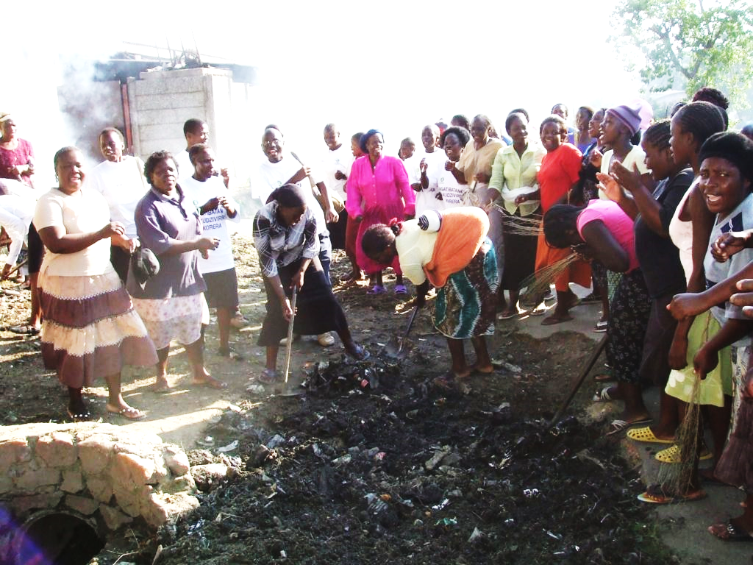
1.18. Best place to start a CHC?
Urban slum
Rural village
Notes:
1.18. Best place to start a CHC
Is it ‘better’ to start a CHC in an area which is homogenous or non homogenous?
This is a trick question: What do we mean by ‘better’?
The best place in terms of making a difference is obviously to start a CHC is in the area of most need, therefore we would select a place which is less homogenous with the intention of improving Social Networks. However, it is going to be a harder job. The bonus is that there is likely to be a higher rate of change between the low base line and the high achievement.
But if we want a ‘quick win’, we should select a community which has already a strong sense of Common Unity because it will be easier to start up a CHC but there maybe less change to show for our efforts as the base line is already high.
Compare for example the difference between an informal settlement in an urban slum and a rural village.
Which is likely to have better social networks?
Obviously, the rural village, because they have more ‘in common’ with each other.
But where is the greater need? In an urban setting where many migrants may have no network and are therefore battling to survive.
A rural community maybe poor, but it has resources because it can rely on the social capital that exists within the village eg. Share harvesting or ploughing or funerals.

Slide 21
1.19. COMMUNITY = Common Unity
If we share:
Experience : living together
Knowledge: learning together
Understanding: analyzing together
Beliefs: thinking together
Attitudes: behave the same
Notes:
1.19. Common Unity
A community that shares experience, by living together
Knowledge by learning together
Understanding by analyzing challenges together
Beliefs by thinking things out together
Attitudes by having common standards of behaviour

Slide 22
1.20. What is COMMUNITY HEALTH
A community that can:
manage its own hygiene and sanitation
thereby controlling all preventable diseases
supporting the vulnerable
ensuring a healthy and safe environment
Notes:
1.20. What is Community Health?
A Community that can
Manage its own health issues
By controlling all preventable diseases
Supporting the vulnerable
Ensuring a healthy environment
With safe access to water sanitation and hygiene

Slide 23
1.21. What is the difference?
Gathering of people: ad hoc collection of people
Group of people: some common interest
Club of members: identifiable, registered and regular group
Notes:
1.21. What is a Club
Gathering of people: ad hoc collection of people
Group of people: some common interest
Club of members: identifiable, registered and regular group

Slide 24
1. 22. Definition of a
Community Health Club?
A Community Health Club is a voluntary group of registered members who are responsible for improving public health standards and living conditions in the village.
Notes:
1.22. What is a Community Health Club?
A Community Health Club is a group of people who are responsible for improving public health standards and living conditions in the village.
This is a voluntary, non discriminatory club to which everyone can belong: men, women and children, old, middle-aged or young, rich or poor, educated or not.
It is a free non-political and non-religious forum for improving living conditions and family health through hygiene behaviour change with a view to controlling all preventable diseases without relying on external support.
All the households in every village should have at least one person as a CHC Member.
CHCs should be as large as possible
Members meets once a week for a few hours to learn about health and hygiene with an view to monitoring all public health issues of the community.
Members are bound together by recognition of standards of hygiene and rights of men, women and children to a healthy, productive and dignified life.

Slide 25
1.23. Vocabulary 1
Community: people living in the same location and sharing a common vision
‘community’: people living in the same geographical location
Common Unity – share common vision for the area
Critical mass – the larger proportion of a population
Dysfunctional – inability to manage without assistance
Focal Person – the most networked person in a community
Friends – those people who you meet most weeks
Notes:
Acquired – to personally achieve / earn some quality or status
Ascribed – to be born with some quality or status
Community: people living in the same location and sharing a common vision
‘community’: people living in the same geographical location
Common Unity – share common vision for the area
Critical mass – the larger proportion of a population
Dysfunctional – inability to manage without assistance
Focal Person – the most networked person in a community
Friends – those people who you meet most weeks

Slide 26
1.24. Vocabulary 2
Functional – ability to manage without assistance
Fundamental Need - a basic priority in our lives
Interaction – meeting or activity between people
Homogenous – similar in culture, class and education level
Social Network –communication between people in same geographic area
Social Media – networks between people using digital communication
Social Demographics – the basic information about a person
Notes:
Functional – ability to manage without assistance
Fundamental Need - a basic priority in our lives
Interaction – meeting or activity between people
Homogenous – similar in culture, class and education level
Self efficacy – confidence in one’s own ability
Social Network –communication between people in same geographic area
Social Media – networks between people using digital communication
Social Demographics – the basic information about a person

Slide 27
1.25.How Homogeneous is your ‘community’?
Map the social network in the village
List all the households registered in the CHC
Number all the members /write their number on the map
Ask each member to identify all households of friends
Draw a line from her household to all her friends
Identify the top five most connected people in the CHC
Notes:
Module 1. Assignment
How Homogenous is your community
1. Map the social network in the village
List all the households registered in the CHC
Number all the members and write their number on the map
Ask each member to identify all the households of friends
4. Draw a line from her household to all her friends
5. Identify the top five most connected people in the CHC

Slide 28
1.24. Homework: Demographic Information
Demographic information from each family
Size of Household
Ethnic group
Mother tongue
Religion
Level of Education
Occupation
Sanitation status
Notes:
Using the Survey form provided
find out Demographic information from each family
Size of Household
Ethnic group
Mother tongue
Religion
Level of Education
Occupation
Sanitation status

Slide 29
to city
SANGANO VILLAGE
8
9
6
7
5
1
2
3
4
15
16
14
Primary School
13
10
11
12
KEY
Main road
Houses
Latrines
Water point
Bus stop
Stall
Solid waste
House number
Shops
Health Centre
20
to sea
22
18
21
23
17
19
24
24
24

Slide 30
The Video:
Community Health Clubs creating Common Unity
https://vimeo.com/462614695
TED TALK by Jason Rosenfeld
https://www.youtube.com/watch?v=ug3D0B4gcjs
Case study is: Haiti https://www.africaahead.org/countries/haiti/
Dominican Republic
The article:
‘Social capital and community health clubs in Haiti’
https://www.africaahead.org/wp-content/uploads/2020/09/2010.-Common-Unity-in-CHCs.pdf
rder No. 13le from ProQuest Dissertations & Theses Global. (2296700336).

